Slide 1

Turbulence Modelling for Smoothed Particle Hydrodynamics
K T Prajwal Prathiksh
Dual Degree Project (Stage I) - Presentation
Supervisor: Prof. Prabhu Ramachandran
Department of Aerospace Engineering
Indian Institute of Technology Bombay
October 25th, 2022
Notes:
Buy Aeroelasticity (Dover Books on Aeronautical Engineering) Book Online at Low Prices in India | Aeroelasticity (Dover Books on Aeronautical Engineering) Reviews & Ratings
Merging Radius between two vortices
Summarize the russian paper
Sine wave/Saw tooth wave/Squre wave - heaving motion for the cylinder

Slide 2
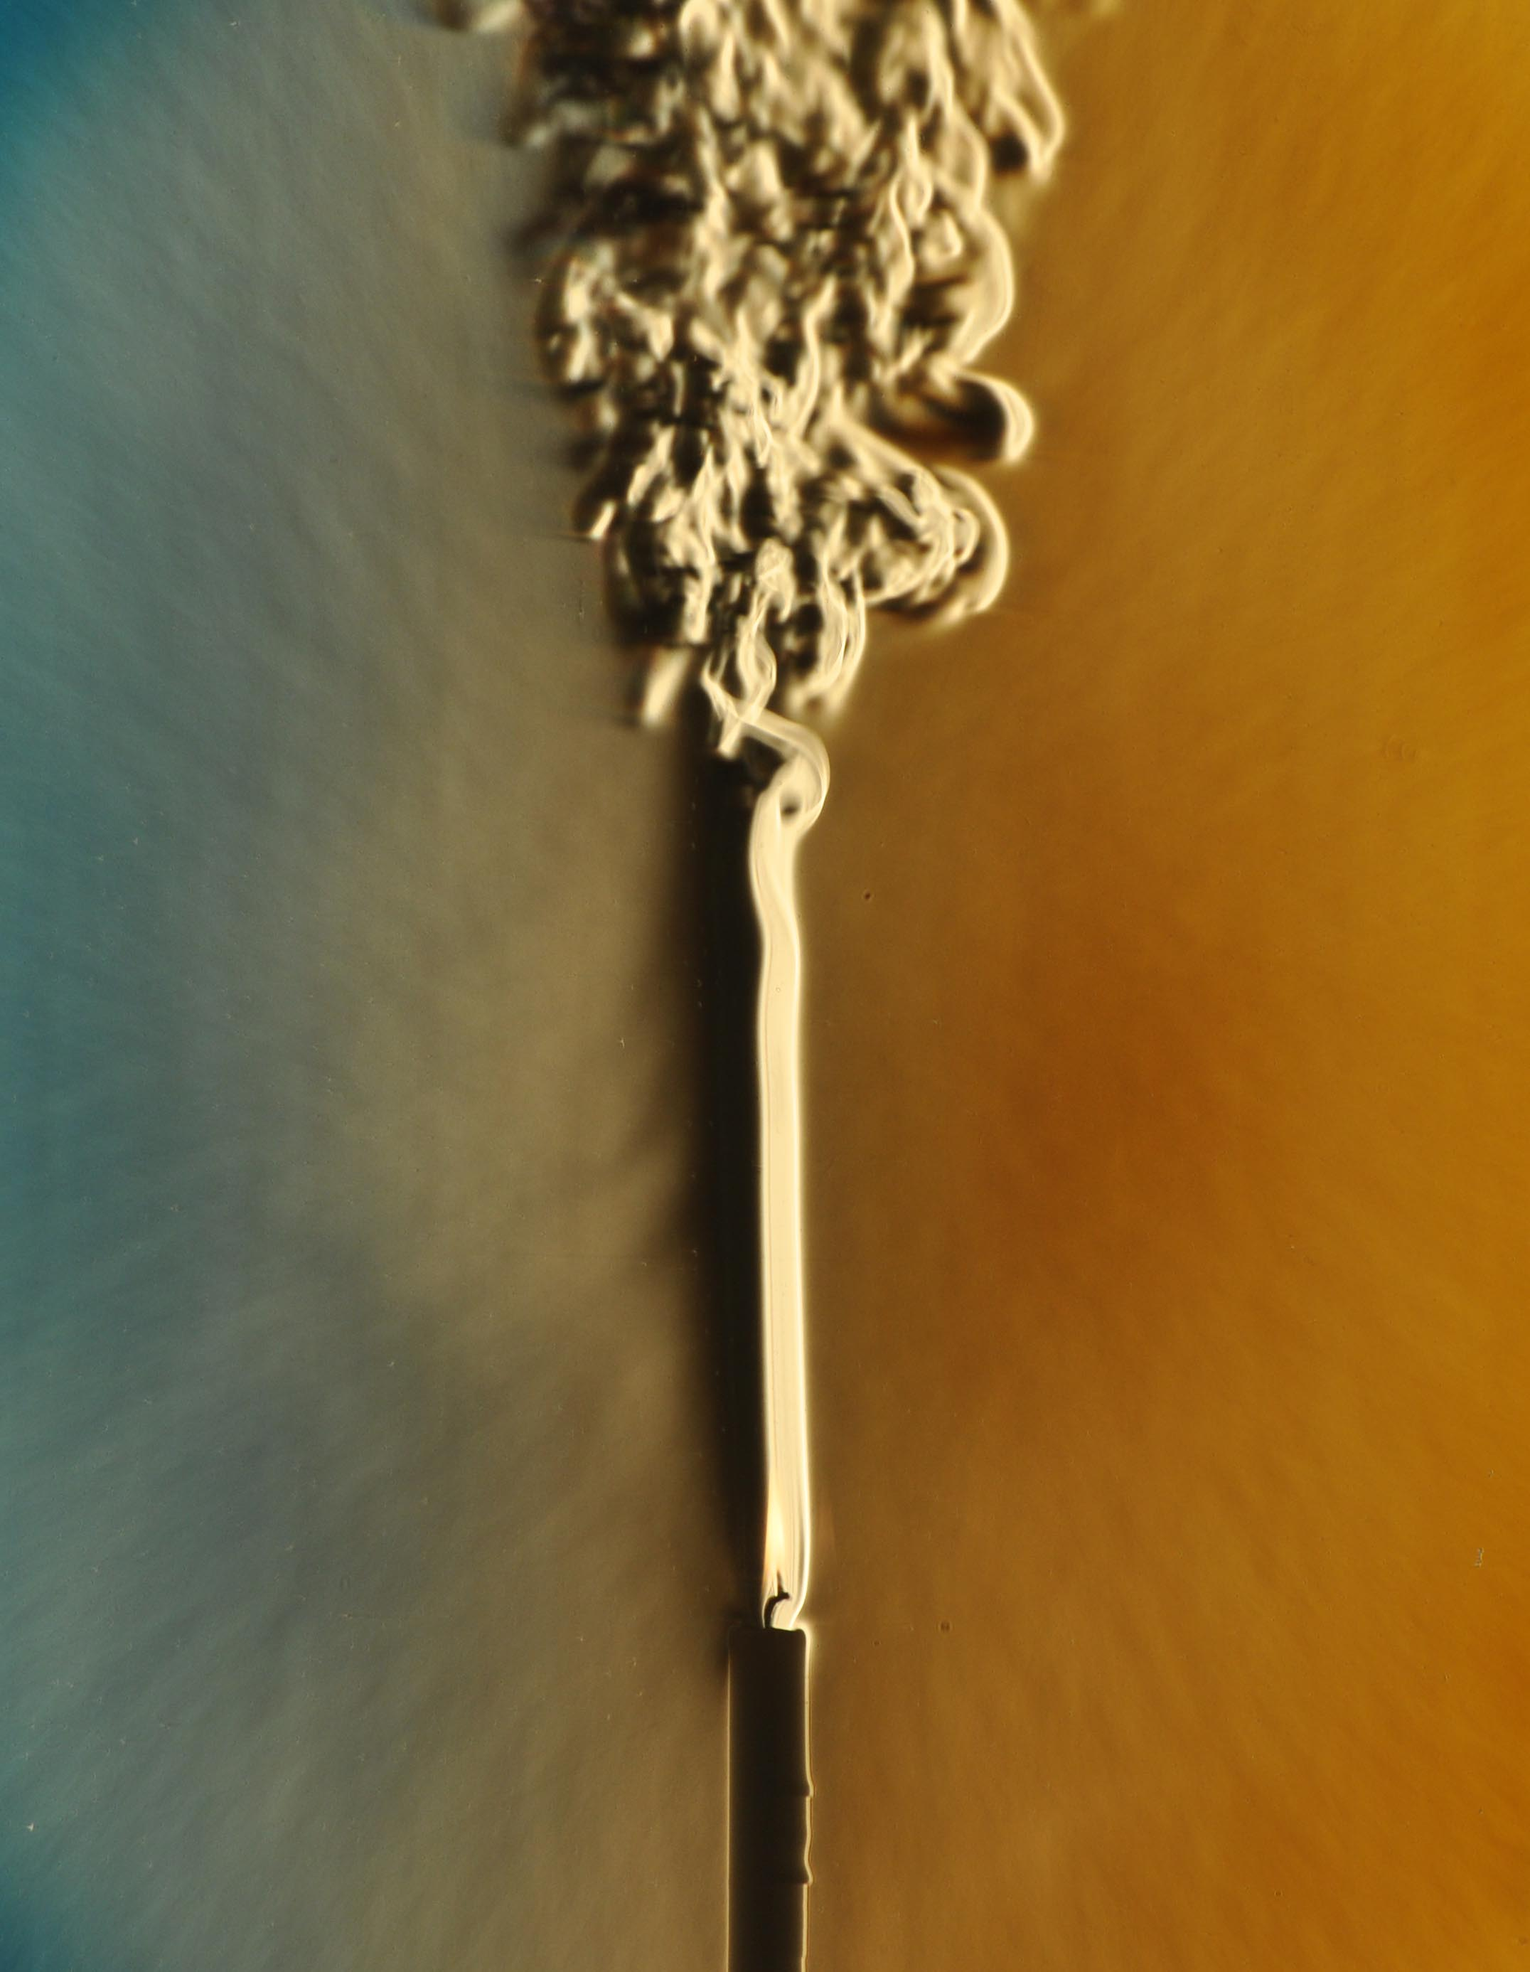
Introduction
Turbulent Flow:
Characterization:
High Reynolds number flows
Random spatial & temporal velocity fluctuations
Rotational & 3D velocity field
Large mixing capacity of the flow
Chaotic nature of the solutions
Modelling:
Lack analytical solutions except for simple flow cases
CFD simulations required for complex flow cases
Typical modelling techniques
Governing equations → Averaged or filtered
Closure problem → Model fluctuating components using mean flow properties
Stochastic methods
Eulerian frameworks
Lagrangian Modelling – SPH:
No background mesh required → Large deformations, complex boundary dynamics
Simplifies model implementation and parallelization to multi-core architectures

Slide 3
Project Objectives
Turbulence Modelling in SPH
Lacks robust models
Shortcomings of current models –
Cannot be generalized to various turbulence-based problems
Issues in scaling to 3D flows
Project Objective
Review state of the art turbulence models in SPH
Provide advantages & disadvantages of the major classes of models
Extend promising models to robust & accurate SPH schemes [negi]
Analyze & study its performance in bounded turbulent flows

Slide 4
Turbulence Modelling
Surveyed research papers detailing work on turbulence models for SPH (c. 2000 – 2022)
Classified 5 major categories of turbulence models
[chart]
Identified a systematic, model-evaluation method
Benchmark problems amenable to SPH
Post-simulation analysis techniques

Slide 5
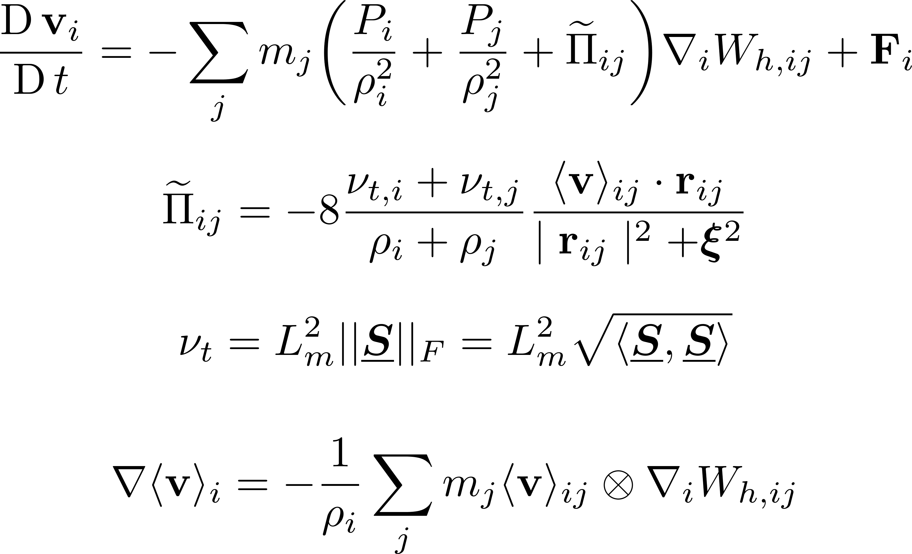
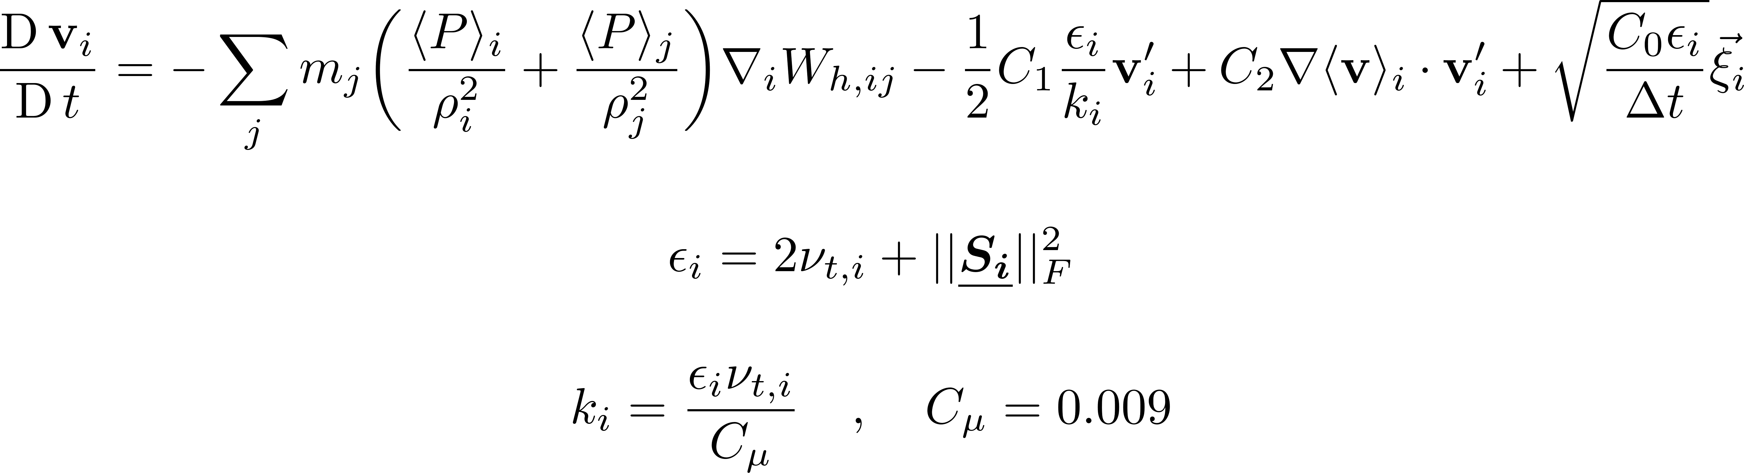
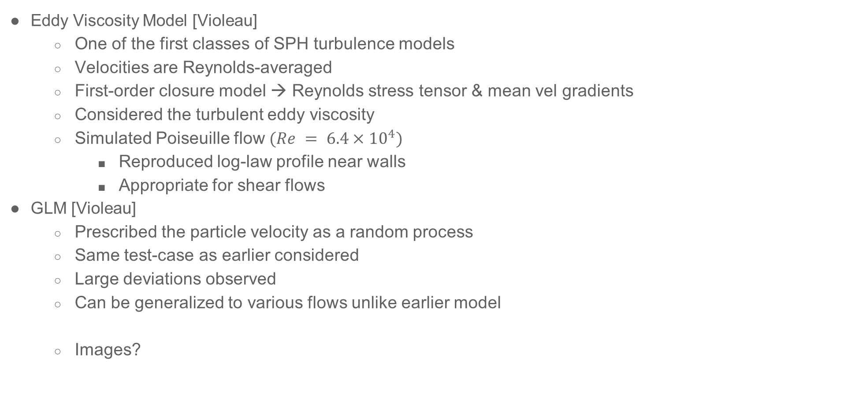
Viscosity-based Models
Eddy Viscosity Model [Violeau]
One of the first classes of SPH turbulence models
Velocities are Reynolds-averaged
First-order closure model → Reynolds stress tensor & mean vel gradients
Considered the turbulent eddy viscosity
Simulated Poiseuille flow $(Re = 6.4×{10}^{4})$
Reproduced log-law profile near walls
Appropriate for shear flows
GLM [Violeau]
Prescribed the particle velocity as a random process
Same test-case as earlier considered
Large deviations observed
Can be generalized to various flows unlike earlier model
Images?
[1] Dynnikova, G. Ya et al. (2021). “Stability of a reverse Karman vortex street”. In: Physics of Fluids 33.2. ISSN: 10897666. DOI: 10.1063/5.0035575.

Slide 6
Viscosity-based Models
Eddy Viscosity Model [Violeau]
One of the first classes of SPH turbulence models
Velocities are Reynolds-averaged
First-order closure model → Reynolds stress tensor & mean vel gradients
Considered the turbulent eddy viscosity
Simulated Poiseuille flow $(Re = 6.4×{10}^{4})$
Reproduced log-law profile near walls
Appropriate for shear flows
GLM [Violeau]
Prescribed the particle velocity as a random process
Same test-case as earlier considered
Large deviations observed
Can be generalized to various flows unlike earlier model
Images?
[1] Dynnikova, G. Ya et al. (2021). “Stability of a reverse Karman vortex street”. In: Physics of Fluids 33.2. ISSN: 10897666. DOI: 10.1063/5.0035575.

Slide 7
Thank you!
Department of Aerospace Engineering
Indian Institute of Technology Bombay
October 25th, 2022

Slide 8
Blank Template Slides

Slide 9
[1] Dynnikova, G. Ya et al. (2021). “Stability of a reverse Karman vortex street”. In: Physics of Fluids 33.2. ISSN: 10897666. DOI: 10.1063/5.0035575.

Slide 11
Filled Template Slides

Slide 12
Project Motivation
Simulation Parameters
Reynolds number
Swimming trajectories
Single/Multi Swimmers
Placements & Configurations
Boundary Conditions
Geometry
And many more...
Study of Forces
Motion of Biological Swimmers
High-Fidelity - CFD Solvers
Study of Energetics
Develop underwater vehicles with:
better mobility
lower noise
higher endurance
efficiency
Low-Fidelity - Theoretical or Computational Frameworks
Project Outcome
Gain better understanding of the problem at hand
Utilizes lesser resources
Allows for faster iteration over models

Slide 13
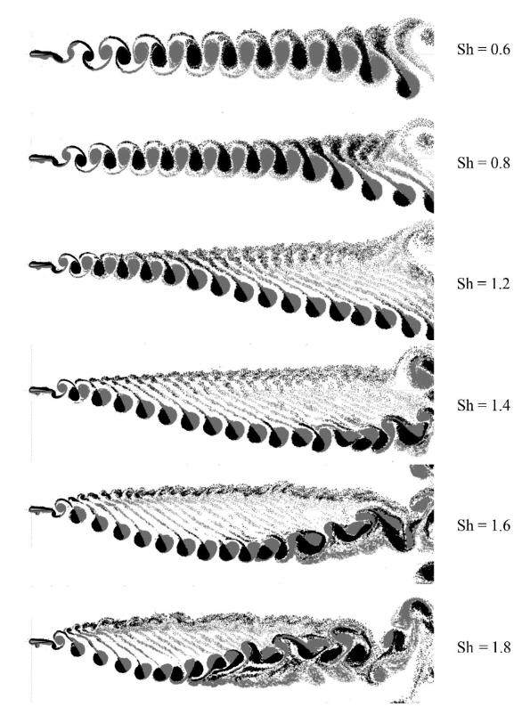
Conclusion
Thrust produced continuously → Output is not stable.
Sharp peaks in thrust production coincide with vortex shedding.
Airfoil starts its heaving motion with downwards stroke → Small negative lift is produced (average)
Airfoil starts its heaving motion with upwards stroke → Small positive lift is produced (average).
General trend in bulk movement of shed vortices as shown by Dynnikova^{[1]} is observed.
Fig: Vortex wakes behind an airfoil performing angular oscillations^{[7]}
[1] Dynnikova, G. Ya et al. (2021). “Stability of a reverse Karman vortex street”. In: Physics of Fluids 33.2. ISSN: 10897666. DOI: 10.1063/5.0035575.

